Slide 1

Invasive Insects and Effects on US Agriculture Analysis
By: Ali Ugur (agu6)

Slide 2

Motivation
The reason as to why I did this project was:
Invasive insects behave differently across ecosystems, best example is European honey bees produce honey, but most native North American bees do not
These differences show how introducing species into new environments can create unexpected ecological impacts
This project investigates non-native scale insects in the United States and identifies ecological and economic factors that predict high-risk introduction years

Slide 3
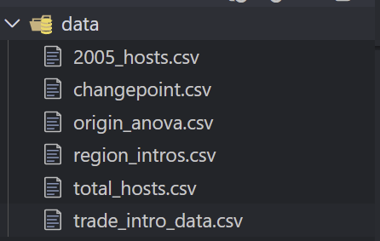
Datasets Used
Six ecological datasets were combined:
changepoint.csv – yearly introduction counts
origin_anova.csv – species origin and introduction year
region_intros.csv – first region where each species was detected
trade_intro_data.csv – annual trade quantity
2005_hosts.csv – host plant categories present in 2005
total_hosts.csv – all host plant records across species
These datasets cover species-level and year-level information, allowing us to connect trade, origin, host plants, and geographic spread to patterns of invasive introductions.

Slide 4
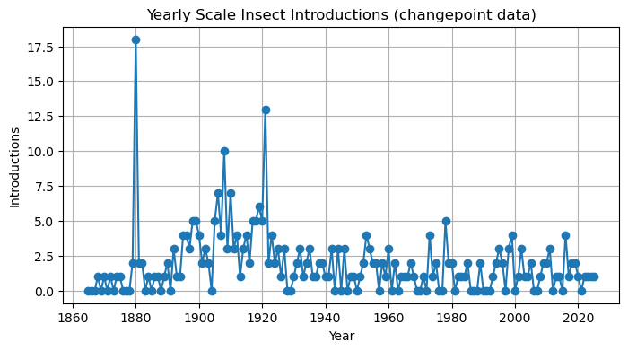
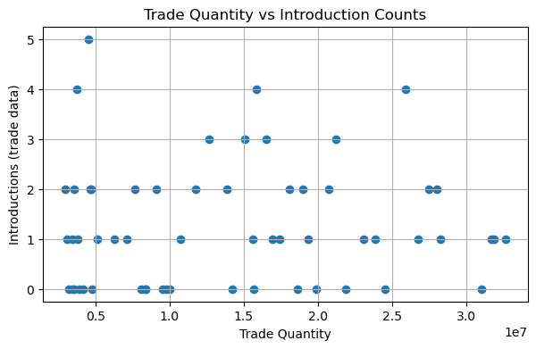
EDA (Exploratory Data Analysis)
After Data Cleaning and Merging, the following charts show that introduction counts rise over time with some distinct peaks.
Higher trade volume aligns with more introductions.
Vulnerable hosts include fruits, grasses, and multi-host species.
EDA reveals that both ecological and economic factors shape introduction patterns.

Slide 5
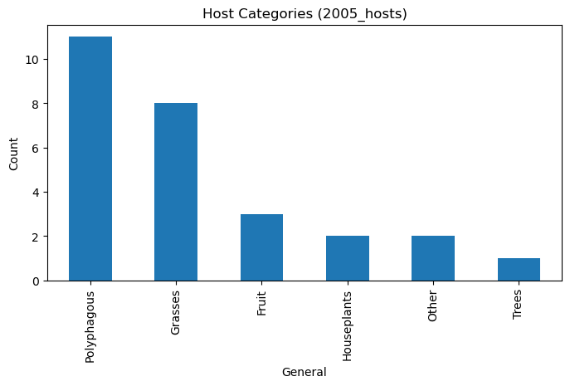
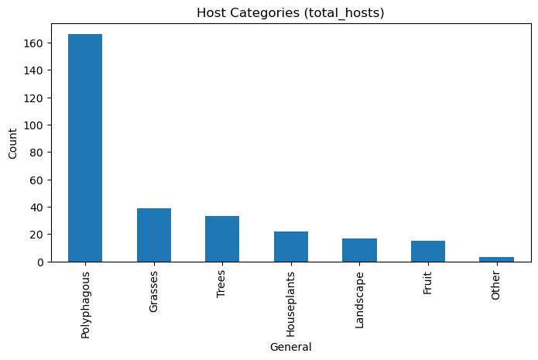
EDA (continued)

Slide 6
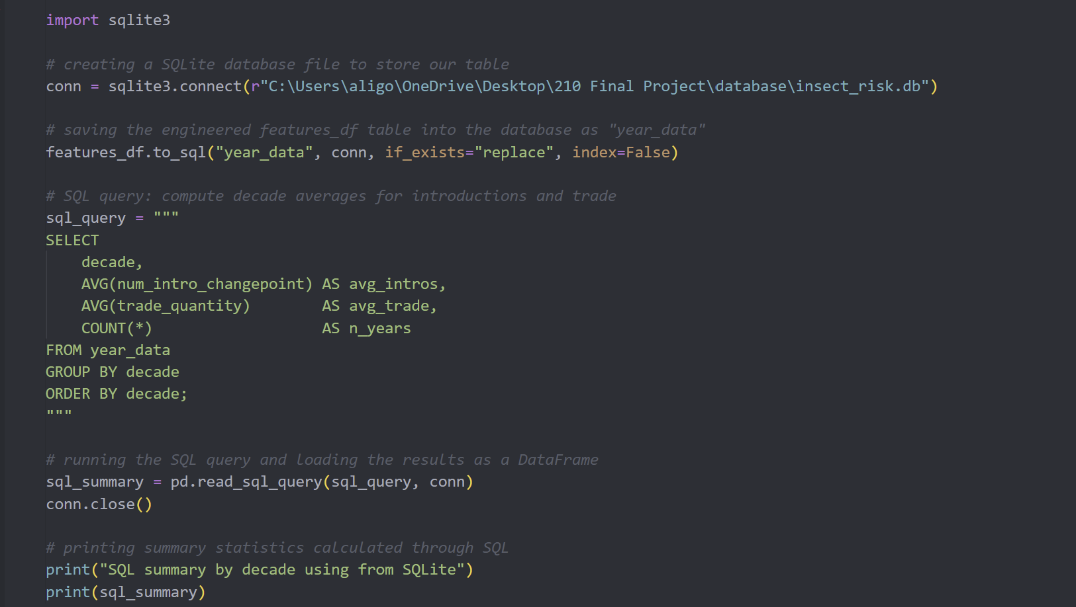
SQL Analysis
Using the engineered dataset stored in insect_risk.db, SQL queries computed decade-level averages for introduction counts and trade quantity.
Takeaways:
Both introductions and trade steadily increase across decades.
Modern decades consistently show the highest ecological risk.
SQL confirms the same trends observed in EDA and modeling.
SQL serves as a secondary verification tool for long-term patterns.

Slide 7
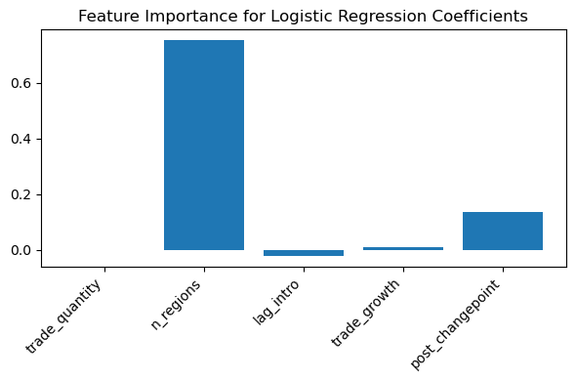
Machine Learning Models & Plots
Models Applied:
Linear Regression for predicting introduction counts
Logistic Regression for classifying high vs. low risk years
K-Means Clustering for identifying ecological and trade-based groups
K-Nearest Neighbors for finding similar historical years
Key takeaways:
Linear regression predictions are usually within one species of actual values.
Logistic regression shows n_regions and trade_growth are strong predictors of high-risk years.
K-Means separates years into low, moderate, and high-risk ecological groups.
KNN shows recent years are most similar to one another due to modern trade patterns.

Slide 8
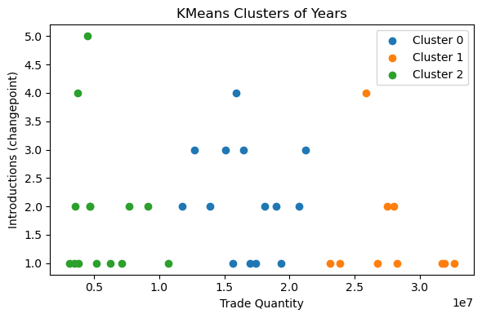
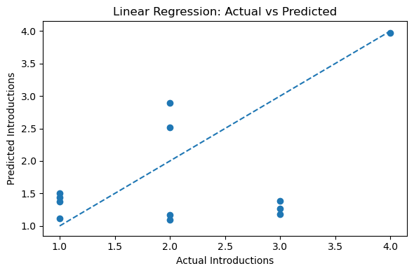
Machine Learning Models & Plots

Slide 9

Conclusion
Trade activity, geographic spread, and ecological momentum work together to shape yearly invasion risk. High-risk years often occur when trade is high, multiple regions detect new species, and the previous year had elevated introductions.

Slide 10

Thank you!
Company Name
Date

